Slide 1


‘It always seems impossible until it's done’
— Nelson Mandela
January
2021

Slide 2

Value Proposition
1
2
3
4
In 2019-2020 our strategy far outperforms the US stock market (S&P 500)
and the largest hedge funds with equity long/short strategies
The strategy ensures high absolute return (alpha)
The strategy has low beta
Risks are under control — low drawdowns, fast recovery, Sharpe above 1.5 and Calmar above 2.8
ARQuant strategy (after fees)
118%
Andurand Commoditied Discretionary Enhanced
Westbeck Energy Opportunity
Brevan Howard FG Macro Master
Crake Asset Management
Odey Absolute Return Focus
Brevan Howard Master Fund
Millennium Management
The Children’s Investment Fund
154%
84%
61%
48%
46%
27%
26%
14%
The most famous hedge funds
recorded stellar gains in 2020
*Source: Bloomberg reporting, Bloomberg
02
Absolute Return
Quantitative Management

Slide 3

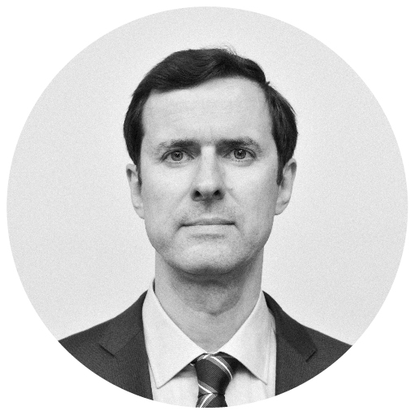
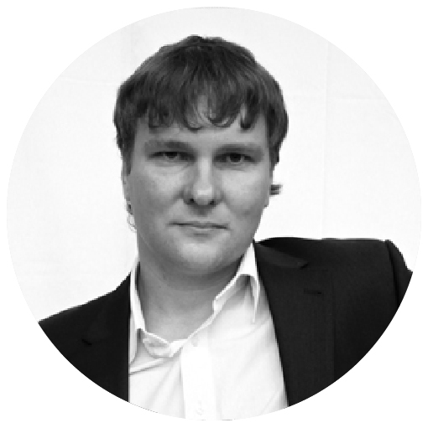
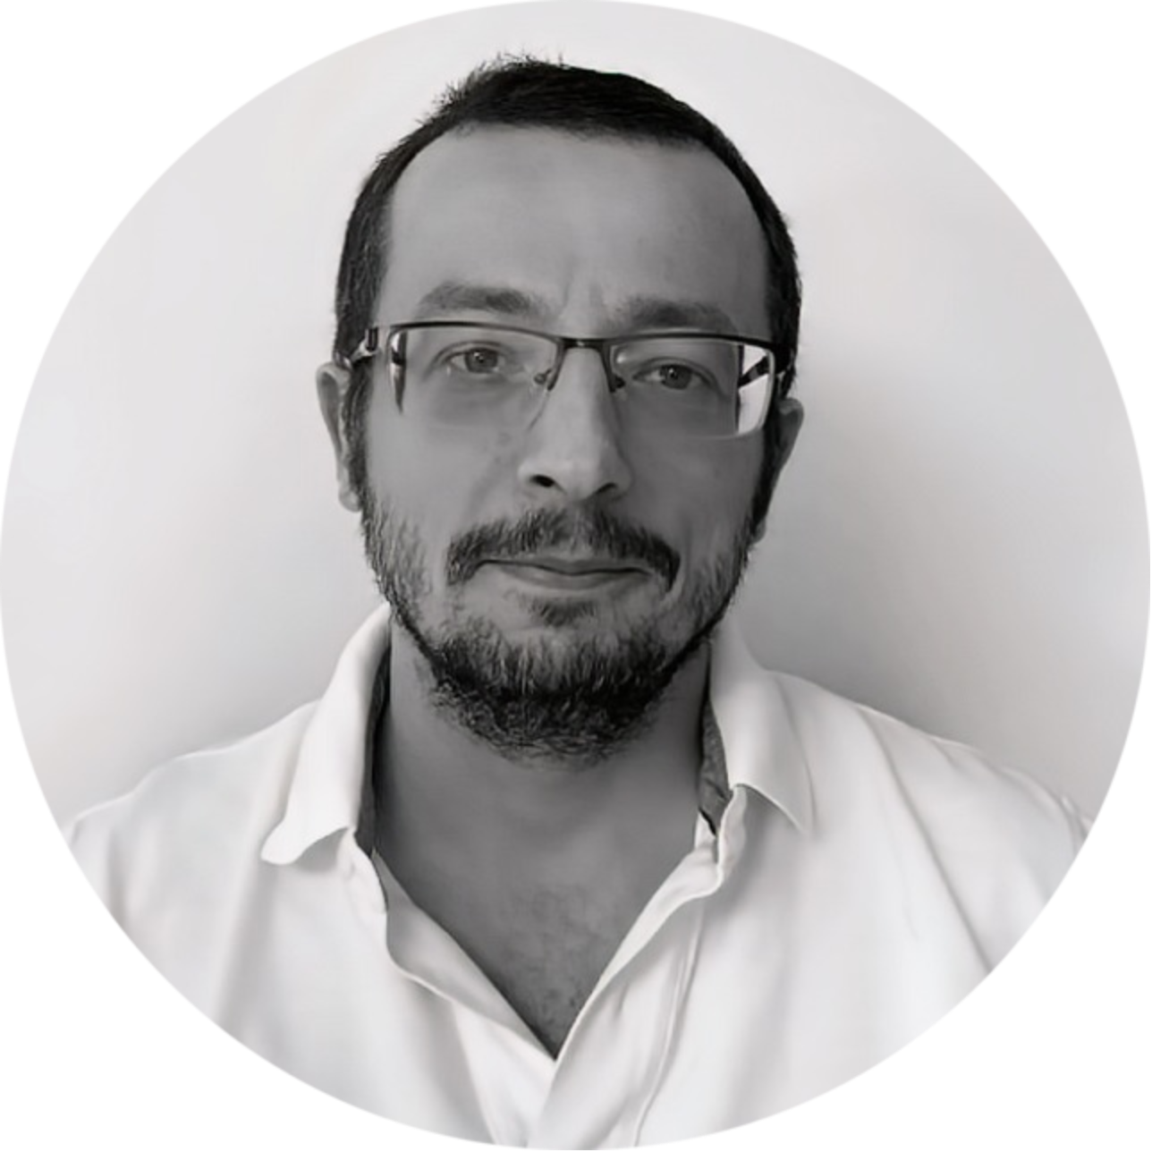
Our Team
Alexander Semenyaka
In 1987 graduated with honors from the Faculty of Computational Mathematics and Cybernetics of Lomonosov Moscow State University, Ph.D. He organized the sale of shares at privatization auctions, debut ADR placements of Gazprom and launch mortgage securitization in Russia.
In 2018 Alexander got MSc in leadership and strategy from London Business School and in 2020 received a certificate from EDHEC business school on asset management using machine learning. Since 2018, he has been selecting and testing unique algorithmic strategies.
Andrew Kartashov
In 2000 graduated with honors from the Faculty of Mechanics and Mathematics of Lomonosov Moscow State University. After he worked as a programmer, lead programmer and head
of division in Russian IT companies. In 2008, Andrew began trading on the Moscow Exchange with his own money and since 2010 his trading is exclusively run by robots. In March 2018,
he launched robotic stock trading on US exchanges.
Dmitry Turevskiy
In 2000 graduated from the Faculty of Mechanics and Mathematics of Lomonosov Moscow State University. Worked as a lead developer, project manager and head of the IT department in software development and fintech companies.
Since 2014 is heavily involved in development of algorithmic trading software
with strong emphasis on financial and mathematical statistics.
03
Absolute Return
Quantitative Management

Slide 4
Engine of the Strategy
The Strategy takes long and short positions in selected US stocks traded on NYSE and Nasdaq. Stock selection is updated quarterly. All investments are short-term, average holding period is about 5 business days. Technical analysis and statistical pattern recognition are used to predict a directional movement.
The main statistical pattern is momentum. The system automatically compares a current momentum with all the available historical data on this and other stocks to understand the possible distribution of future movements. This statistical distribution is then compared to the leverage and direction that is going to be used on this stock in this moment.
Another pattern used is current volatility. Again, the algorithm analyses historical data to understand where a particular stock can move and what are possible dispersion of future movements.
The Strategy has a built-in procedure to manage the drawdown risk – every day it verifies the current drawdown and adjusts leverage.
04
Absolute Return
Quantitative Management

Slide 5

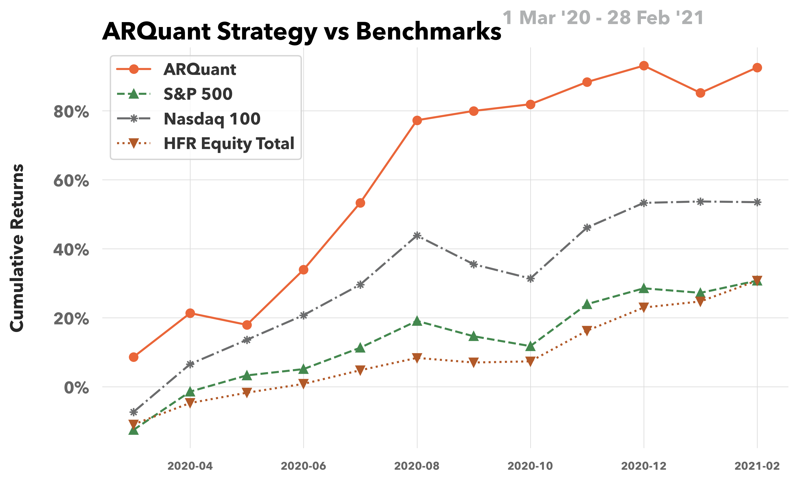
The Strategy
05
Absolute Return
Quantitative Management

Slide 6

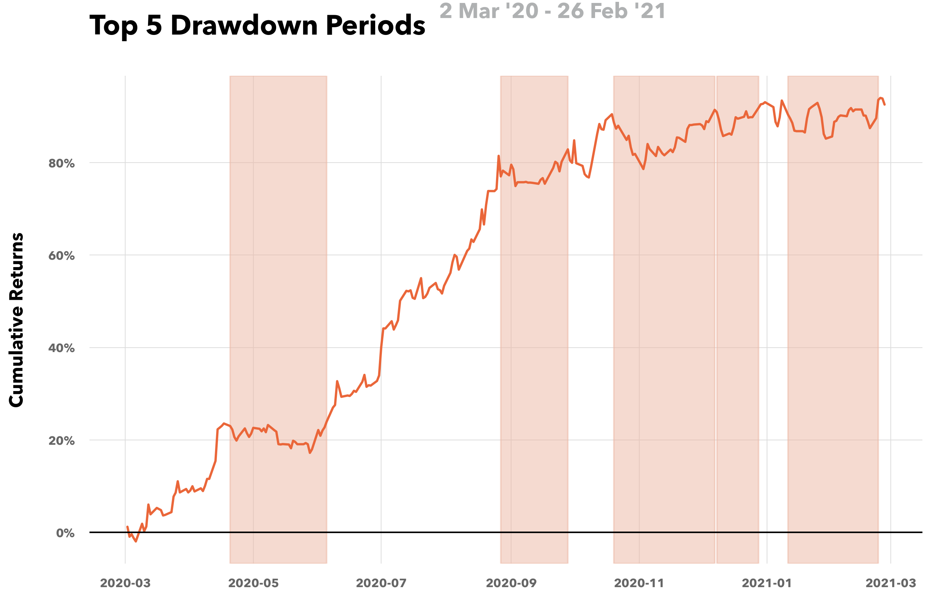
The Strategy (cont.)
06
Absolute Return
Quantitative Management

Slide 7

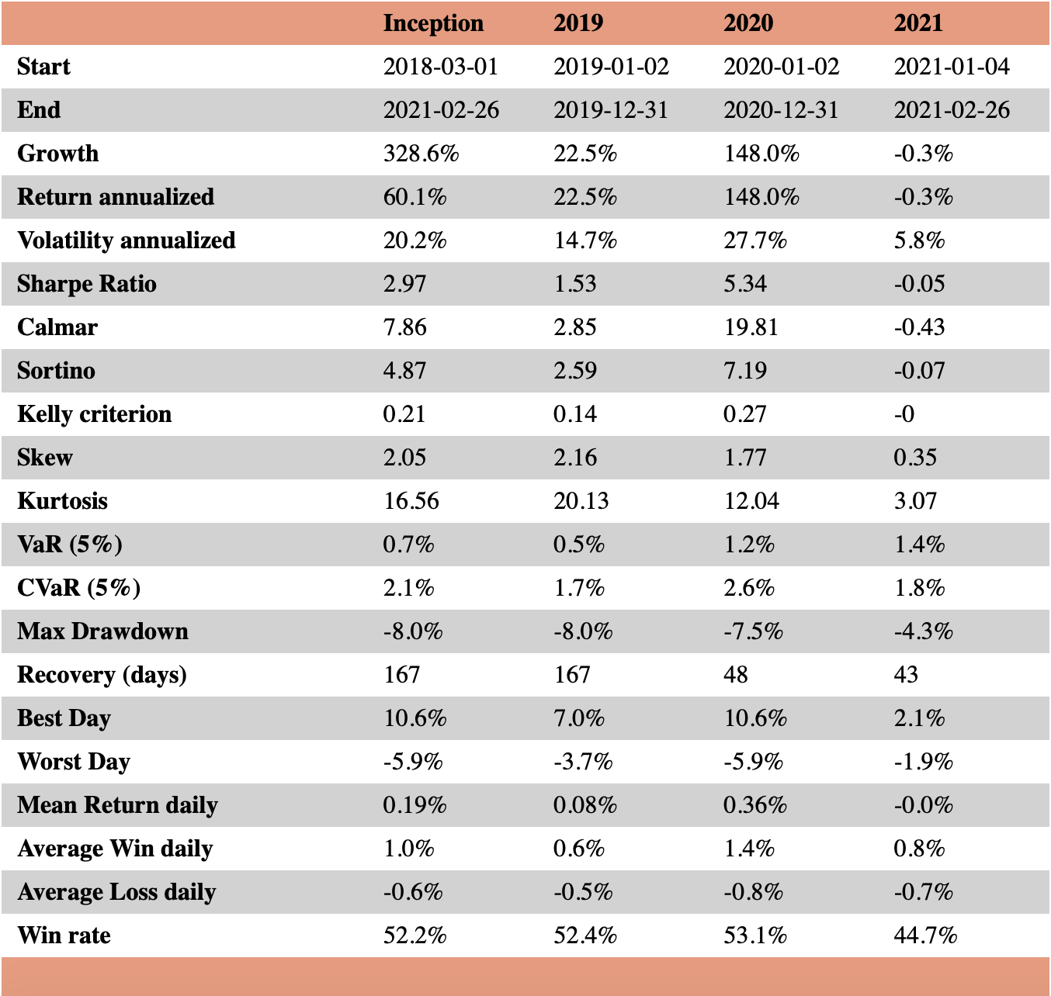
The Strategy (cont.)
Statistics
07
Absolute Return
Quantitative Management

Slide 8

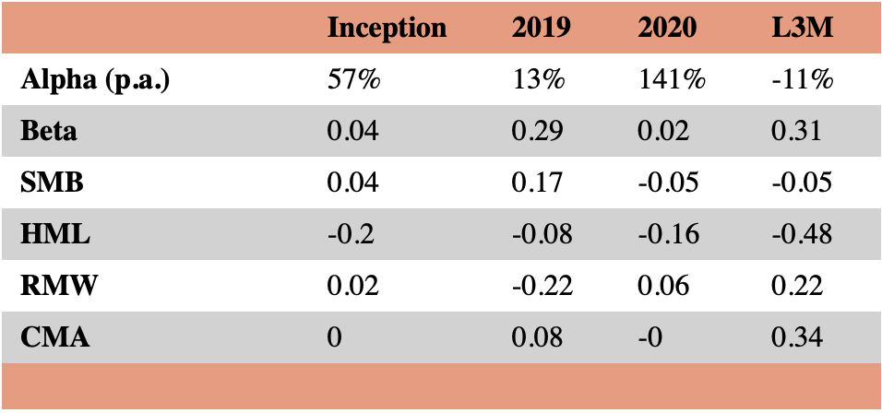
French-Fama model
Alpha, Beta
08
Absolute Return
Quantitative Management

Slide 9

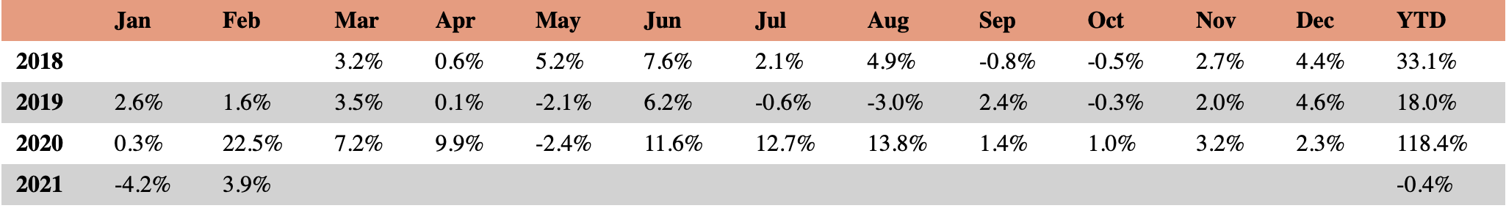
Terms & Fees
AUM band
Management fee
rate (p.a.)
Performance fee (p.a.)
Up to $1’000’000
$1’000’000 - $3’000’000
$3’000’000 - $5’000’000
Above $5’000’000
1.00%
0.85%
0.70%
0.55%
20.0%
18.5%
17.0%
15.5%
Hurdle rate is 5% p.a.
(Example: if annual return is 21% p.a., then the performance equals to 20%-5%=16% p.a.)
Minimum investment is 100,000 USD
Returns after all fees
actual results, non-audited, in USD
09
Absolute Return
Quantitative Management

Slide 10

Our Contacts
Alexander Semenyaka,
CEO
+44 7799 08 7755
alexander@arquant.co.uk
Registered office
ARQuant Management Limited
85 Great Portland Street
1st Floor
London
W1W 7LT
10
Absolute Return
Quantitative Management

Slide 11

Disclosure
This marketing material is not intended for wide distribution and is not intended to advertise financial services and securities or related financial instruments to an unlimited group of persons; it is intended for the named recipients. All recipients of this marketing material are persons with professional experience in matters related to investments or persons with a high level of equity capital or other persons to whom this marketing material may be legally addressed (all the above categories of persons are hereinafter referred to as the "designated recipients"). This material may not be used by persons who are not the said recipients of the material. Any type of investment or investment activity referred to in this material is available only to the named recipients of the material and is related only to the named recipients of the material. The securities described in this marketing material may not be available for sale in all jurisdictions or to certain categories of investors. Derivative financial instruments (options, futures, etc.) are not suitable for all investors and trading in these instruments is considered risky. past performance is not a guarantee of future results. The value of the investment may fall or rise and the investor may not be able to recover the amount of the initial investment. Some investments may become unfeasible due to the illiquidity of the securities market or the absence of a secondary market for the investor's interest, and therefore the evaluation of the investment and the determination of the investor's risk may not be quantifiable. Investments in illiquid securities involve a high degree of risk and are acceptable only to experienced investors who are insensitive to such risks and do not require an easy and quick conversion of investments into cash. Foreign currency-denominated securities are subject to exchange rate fluctuations, which can have a negative impact on the value or price of the investment as well as the income earned from the investment. Other risk factors affecting the price, value or income of an investment include, but are not necessarily limited to, political risks, economic risks, credit risks and market risks. Investments in emerging markets such as Russia, other CIS countries and emerging market securities have a high degree of risk and investors should undertake a thorough preliminary survey before investing. The information contained in this marketing material is not an investment and analytical product. This document has not been created in accordance with the legal requirements to keep the investment analysis objective. This marketing material is not subject to any prohibitions on the distribution of investment analysis products. It has been prepared with all due care to ensure the accuracy of the facts and does not contain deliberately incorrect information, either in whole or in part. The information contained in this marketing material should not be construed as an offer, invitation or inducement to purchase or sell any securities or other financial instruments; it does not constitute advice or personal recommendation or any other form of expression of our opinion on whether a particular security or financial instrument is in your financial or other interests. This information is not based on the specific circumstances related to the specified recipient of this information. The information contained herein has been obtained from various public sources which we believe to be reliable, but we cannot and do not guarantee the accuracy, reliability, currency or completeness of this information. This information is not an exhaustive statement of current financial or commercial developments and may not be used in this capacity. The information and opinions provided are subject to change without notice to the recipients of this information and opinions. This material is not intended for access by retail investors. Investments or investment activities to which this material relates are not available to retail customers and relate solely to persons who are not retail customers. The release and distribution of marketing material and other information relating to securities in certain jurisdictions may be restricted by law. Unless expressly stated to the contrary, this material is intended only for persons who are permitted recipients of this material in the jurisdiction in which the recipient of this material is or belongs. Failure to comply with such restrictions may constitute a violation of the securities laws of that jurisdiction. This material is not intended for access from the territories of the United States of America (including dependent territories and the District of Columbia), Great Britain, Australia, Canada and Japan.
11
Absolute Return
Quantitative Management

